Slide 1

Hackti talent fair 5
Lion Parcel Project
Name : Fachmi maris

Slide 2

Source Dataset : https://github.com/ardhiraka/talent_fair_sample_challenge/blob/main/datasets/lion-loan-train.csv
Objective/Expected Result
Lion Parcel dataset
Able to explain the methodology used for every step, algorithm, data manipulation, data cleansing, etc.
Able to provide chart or any other measureable methods to prove your findings/inferences.
Able to provide in-depth customer profiling based on their loan data.
Able to provide through analysis and story telling based on the data provided
Problem Statement
Build a dashboard to handle dataset provided by Hiring Partner. You can explore your own case based on dataset

Slide 3

DATASET
Column | Description
Loan_ID | Unique Loan ID
Gender | Male/ Female
Married | Applicant married (Y/N)
Dependents | Number of dependents
Education | Applicant Education (Graduate/ Under Graduate)
Self_Employed | Self-employed (Y/N)
ApplicantIncome | Applicant income
CoapplicantIncome | Coapplicant income
LoanAmount | Loan amount in thousands
Loan_Amount_Term | Term of a loan in months
Credit_History | credit history meets guidelines
Property_Area | Urban/ Semi-Urban/ Rural
Loan_Status | Loan approved (Y/N)

Slide 4
DATA CLEANING
Column | Numb of Missing Values
Loan_ID | 0
Gender | 13
Married | 3
Dependents | 15
Education | 0
Self_Employed | 32
ApplicantIncome | 0
CoapplicantIncome | 0
LoanAmount | 22
Loan_Amount_Term | 14
Credit_History | 50
Property_Area | 0
Loan_Status | 0
Handling Missing Values
Removing missing values because number of missing values does not reach 5% of the overall data
Replace data “nan” to “others”
Handling missing values with median value because the data is not normally distributed

Slide 5
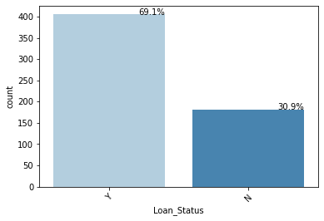
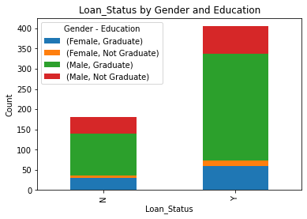
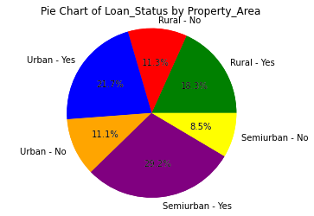
EXPLORATORY DATA ANALYSIS (EDA)
Visualize the target column based on Gender and Education
Visualize the target column based on Property Area
Visualize the column target

Slide 6
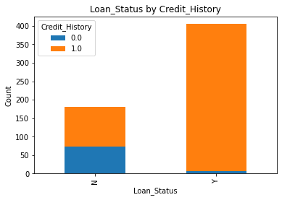
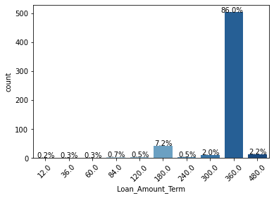
EXPLORATORY DATA ANALYSIS (EDA)
Visualize Loan Status
based on Credit History
Visualize the duration of loan

Slide 7
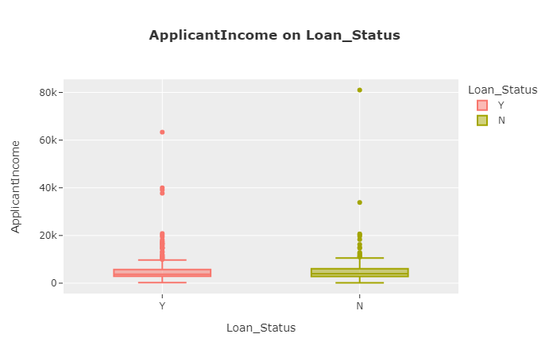
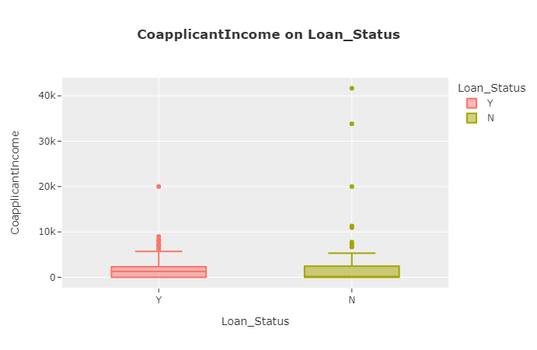
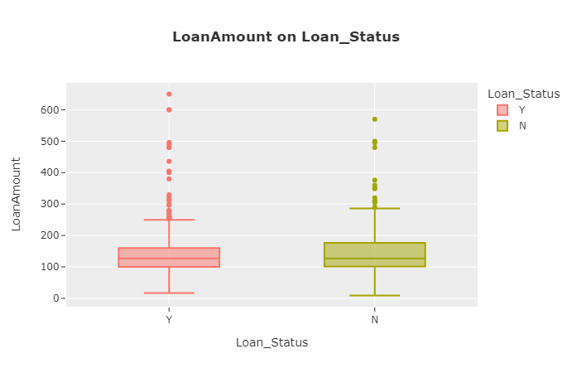
EXPLORATORY DATA ANALYSIS (EDA)
Comparison of vacuum ranges of several numerical features

Slide 8
measure the value of the correlation using ANOVA analysis
Feature | P-value
Loan_ID | 0.5
Gender | 0.59
Married | 0.02
Dependents | 0.94
Education | 0.07
Self_Employed | 0.77
Property Are | 0.43
feature Married has a significant influence on Loan_Status because A low p-value under 0.05

Slide 9
ConCLUSSION
Based on dataset exploration, it is known that the Y status in the Loan_Status column is dominated by male graduates living in the Semiurban area with a loan term of 360 months and an average loan amount of 144K
The feature married has a significant influence on Loan Status based on ANOVA Analsis

Slide 10

ImproveMENT Plan
- We can make machine learning to make predictions based on customer behavior written in the dataset with appropriate algorithms such as Decision Tree, Random Forest, or Logistic Regression.
- Conduct a deeper and detailed examination of missing values ​​to avoid misunderstandings in understanding the data. You can ask the customer directly for validation.
- Can do clustering in order to find out the right market segmentation so as to know the characteristics of customers who are very suitable for Lion Parcel products and evaluate minority segmentation so that they can carry out the right marketing strategy.

Slide 11
Thank you!
Fachmi.maris@gmail.com
https://github.com/Fachmimaris0410

